Slide 1
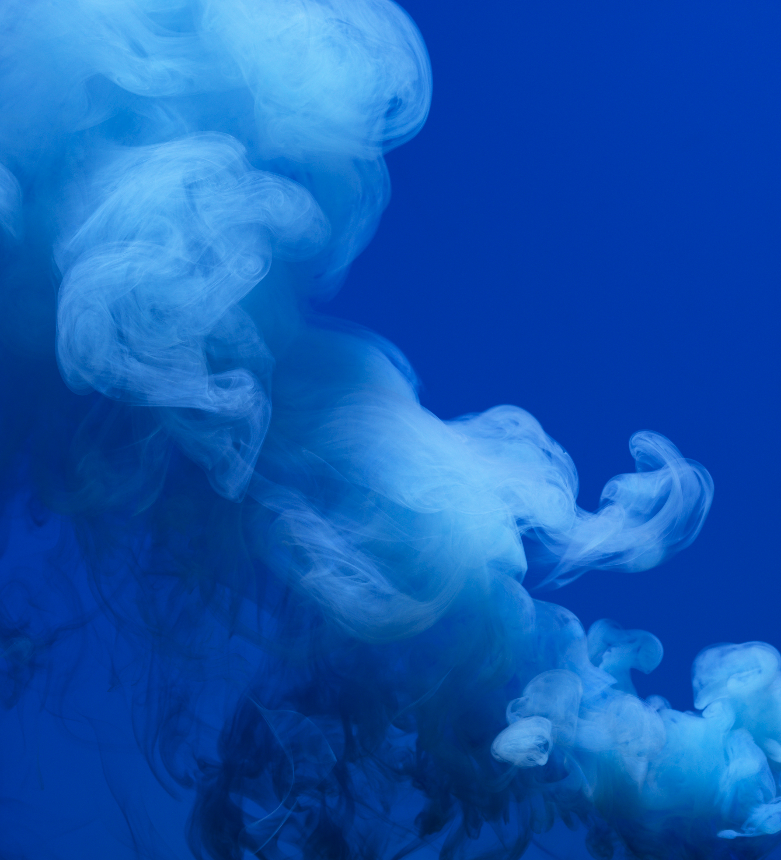
9/30/25
Binary Batch Distillation
Angelica Ramirez, Hiba Naqvi, Jazmin Aca, Srija Bomma

Slide 2
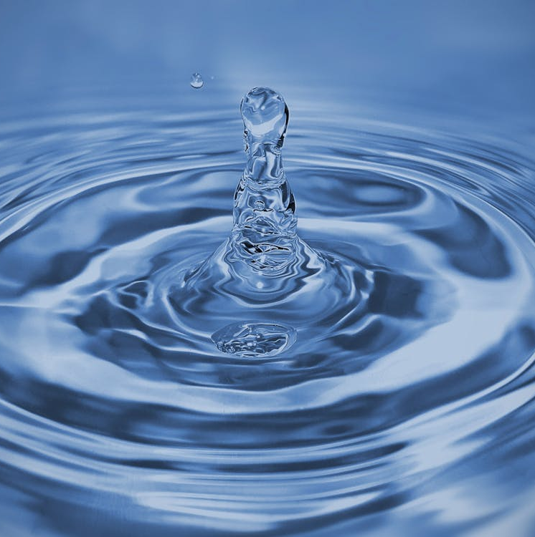
Table of Contents
Introduction
Theory
Apparatus
Materials and Supplies
Procedure
Dangers
Challenges

Slide 3
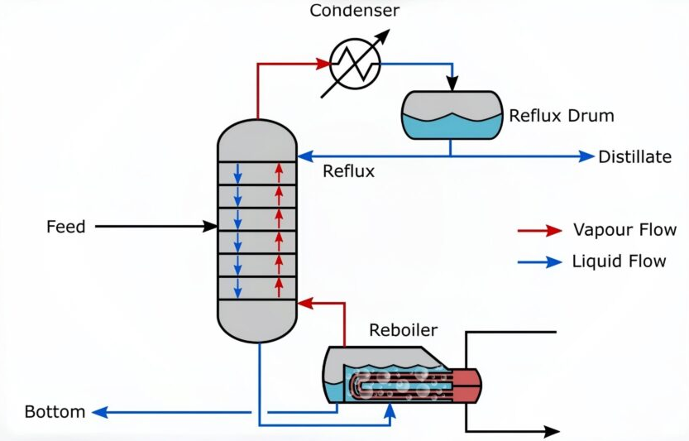
Introduction
The objective of this experiment is to determine the boil-up rate, pressure drop, and overall distillation column efficiency of a batch distillation separation of a 10 wt% ethanol-water mixture. This is achieved by evaluating the effects of reboiler power at total reflux and reflux ratio. Distillation is an equilibrium separation where ethanol favors the vapor phase and water the liquid phase. However, real columns deviate from ideal behavior due to tray inefficiencies, and foaming making experimental analysis essential to evaluate actual column performance.

Slide 4
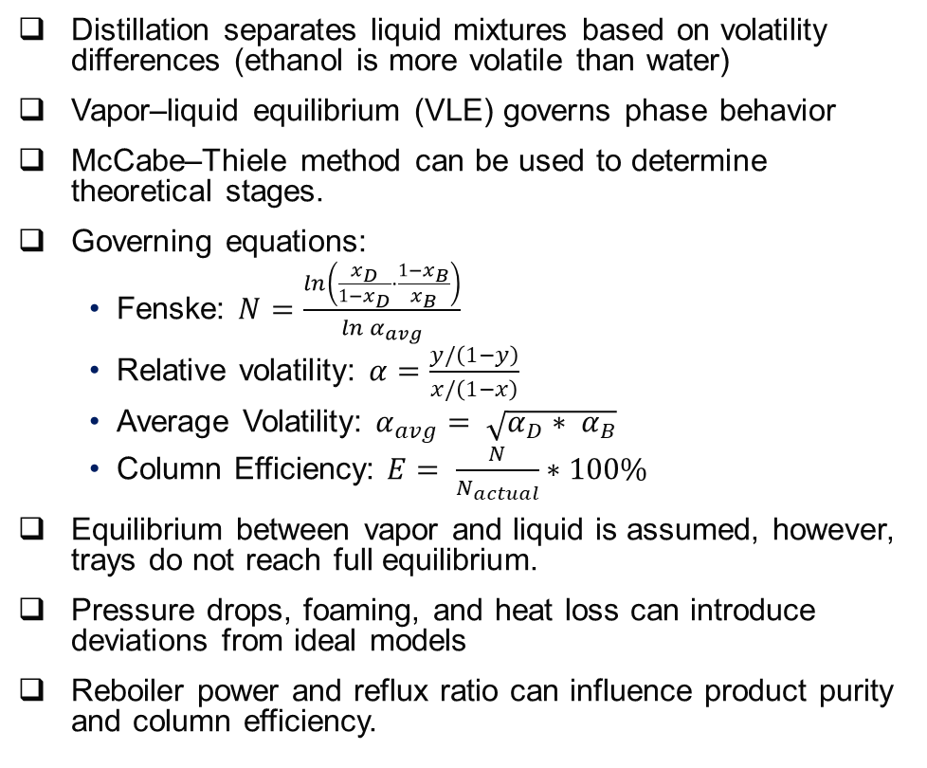
Theory
Distillation separates liquid mixtures based on volatility differences (ethanol is more volatile than water)
Vapor–liquid equilibrium (VLE) governs phase behavior
McCabe–Thiele method can be used to determine theoretical stages.
Governing equations:
Fenske: $N=\frac{\ln\left(\frac{x_{D}}{1−x_{D}}⋅\frac{1−x_{B}}{x_{B}}\right)}{\ln{α_{avg}}}$
Relative volatility: $α=\frac{y/\left(1−y\right)}{x/\left(1−x\right)}$
Average Volatility: $α_{avg}= \sqrt{α_{D}∗ α_{B}}$
Column Efficiency: $E= \frac{N}{N_{actual}}∗100\%$
Equilibrium between vapor and liquid is assumed, however, trays do not reach full equilibrium.
Pressure drops, foaming, and heat loss can introduce deviations from ideal models
Reboiler power and reflux ratio can influence product purity and column efficiency.
Figure 1: Vapor-Liquid Equilibrium for Ethanol-Water System

Slide 5
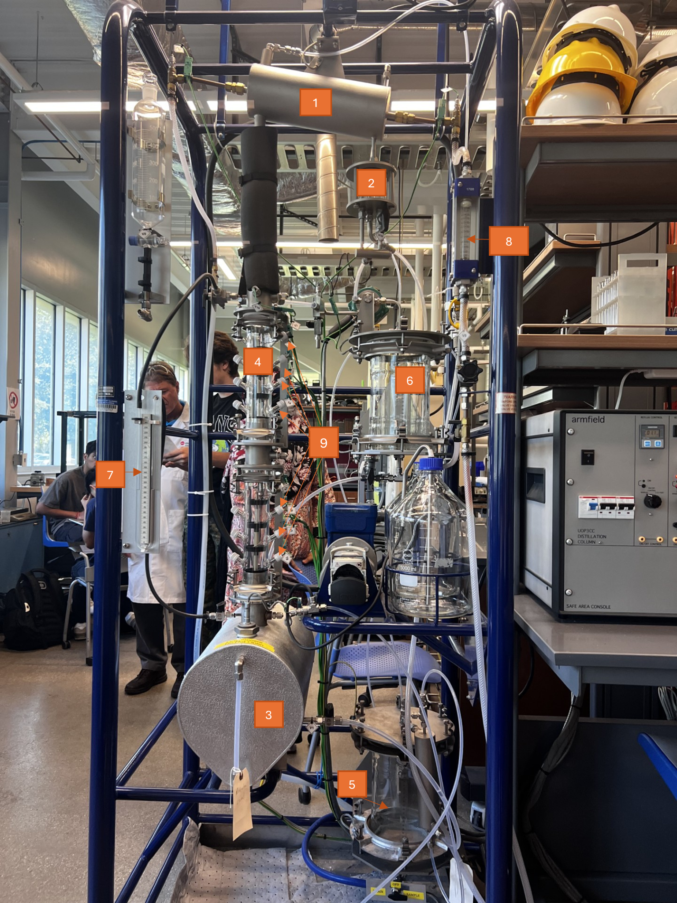
Apparatus
Condenser: Cools and liquefies product
Decanter: Collects condensed product and allows part of it to be returned to the column
Reboiler: Heats the solution to generate vapor
Distillation Column: Provides trays for repeated vapor-liquid contact
Bottom Receiver: Collects bottom product
Top Receiver: Collects distillate
Manometer: Measures pressure of the column
Cooling Water Rotameter: Measures cooling water flowrate
Thermocouples: Measure temperatures at different trays of the column

Slide 6

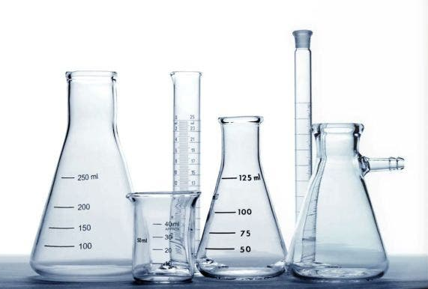
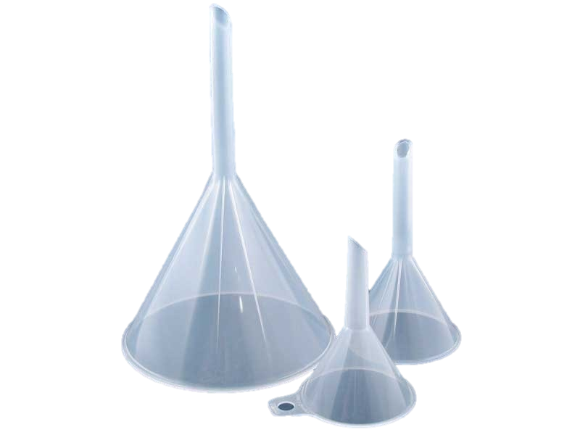
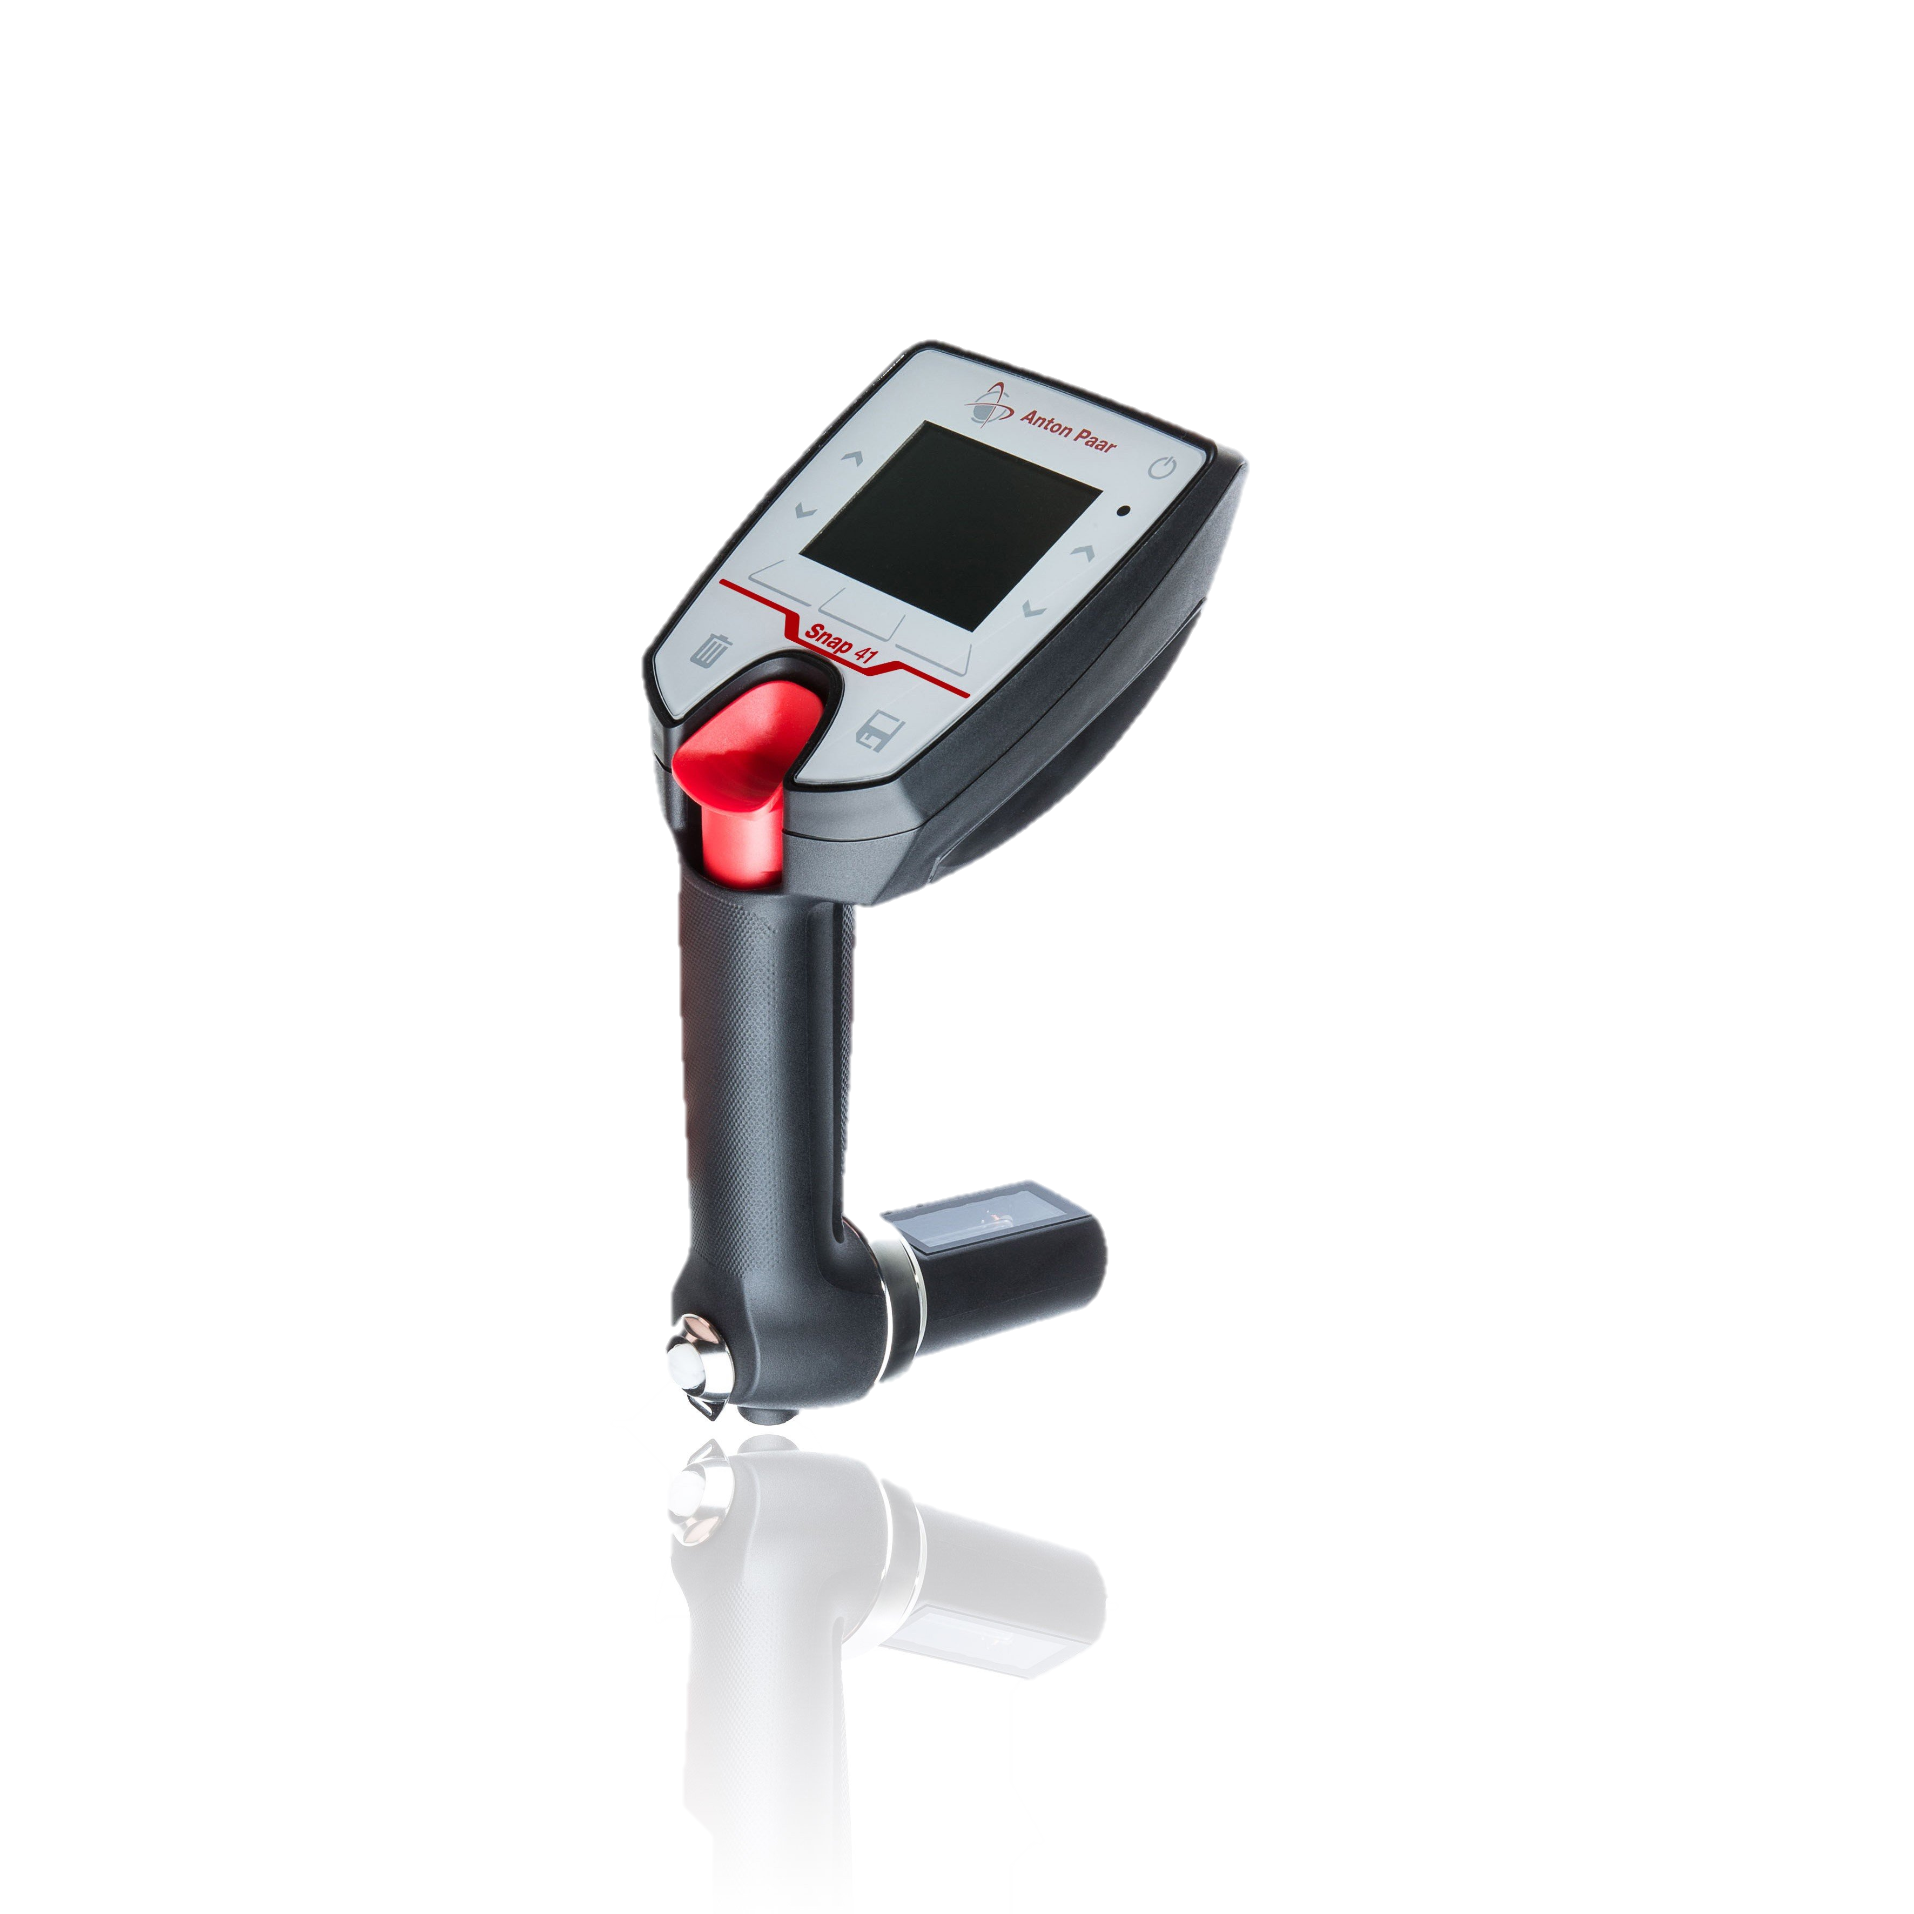
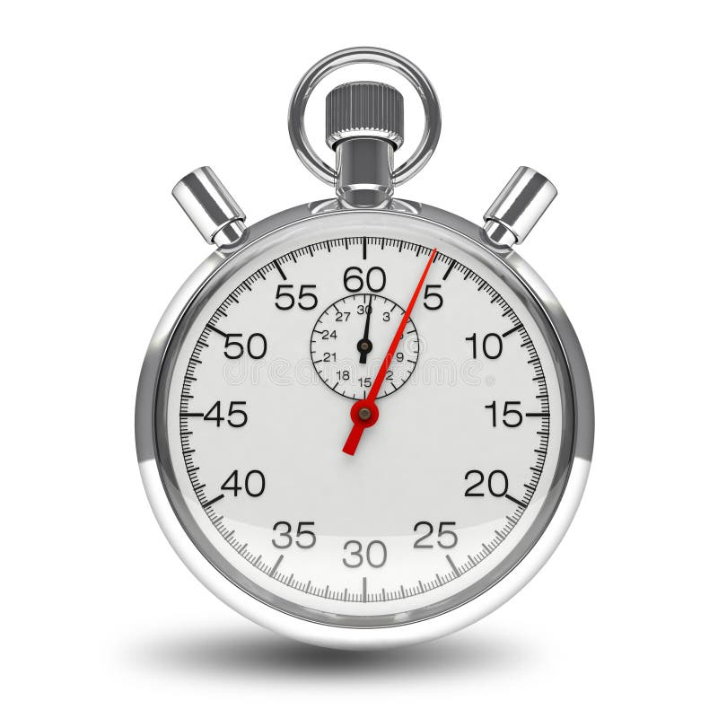
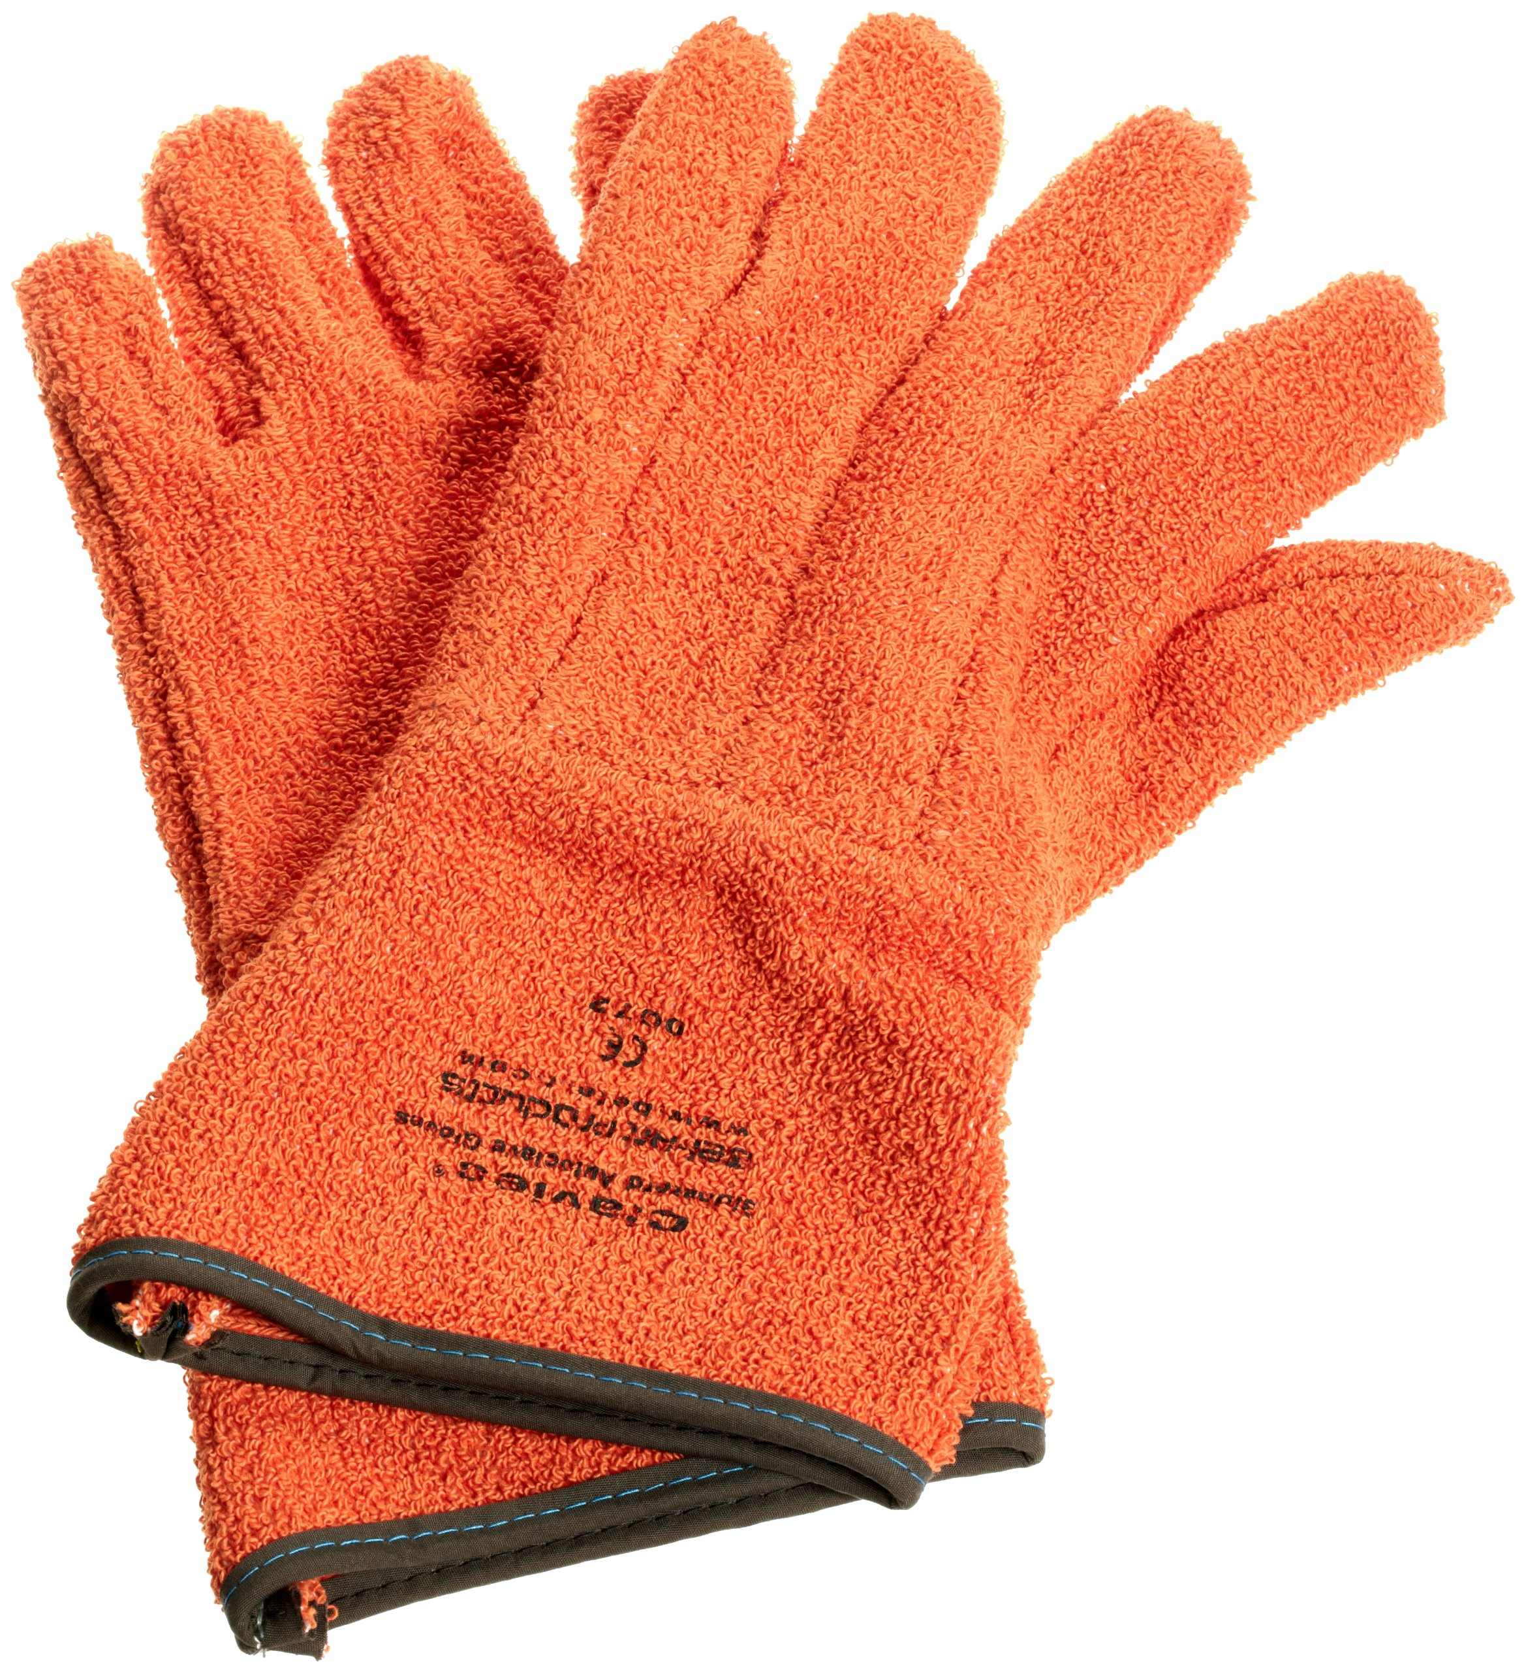
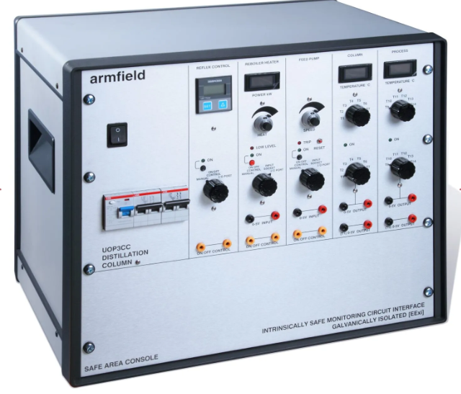
Materials and Supplies
Ethanol
DI Water
Large Beaker
Snap 41
Graduated Cylinder
Collecting Flasks
Control Console
Funnel
Distillation Column
Cooling Bath
Heat gloves
Safety Glasses
Timer

Slide 7

1. Prepare 10 L of a 10 wt% ethanol-water mixture and add to reboiler.
2. Start cooling water at 3 L/min. Check that valves are properly positioned.
5. Start reboiler at 1.5 kW under total reflux.
6. After solution boils, reduce to 0.75 kW and allow system to reach equilibrium.
7. Record tray temperatures every 2 minutes until steady.
8. Determine the boil-up rate by timing condensate collection.
9. Take top and bottom samples. Dispose of initial 5-10 mL and minimize volume of each sample.
10. Record pressure drop and foaming observations.
12. Repeat steps for reboiler powers of 1.0 and 1.25 kW
Procedure
Experiment A

Slide 8
Procedure
Modulate reflux controller to a given ratio (5:1).
Wait about 10 minutes for the column to stabilize.
Collect samples of top and bottom product every 5 minutes for a total of 3 trials.
Determine boil-up rate by timing the top product collection.
Record pressure drop and degree of foaming for each trial.
Record temperatures column trays.
Repeat with at least one more reflux ratio
Experiment B

Slide 9
Dangers
Wires can potentially be exposed to water
Distillation and bottom product will be at a high temperature. Heat gloves are needed
Ethanol is toxic, and flammable. Must be handled in fume hood

Slide 10
Challenges
Ensure that valve of reboiler tank is closed before adding the liquid mixture
Experiment is time consuming. Arrive early
When measuring Pressure open valve V6 first and then V7 to prevent steam from entering the manometer.
Do a trial run before starting the actual experiment

